Slide 1
IERG 4999 Final Year Project Presentation
Group C1 Encrypted Cloud Storage for smartphones
Supervisor: CHAU, Sze Yiu
Name: IP Shing On SID: 1155109011
Name: WONG Shing SID: 1155109027

Slide 2
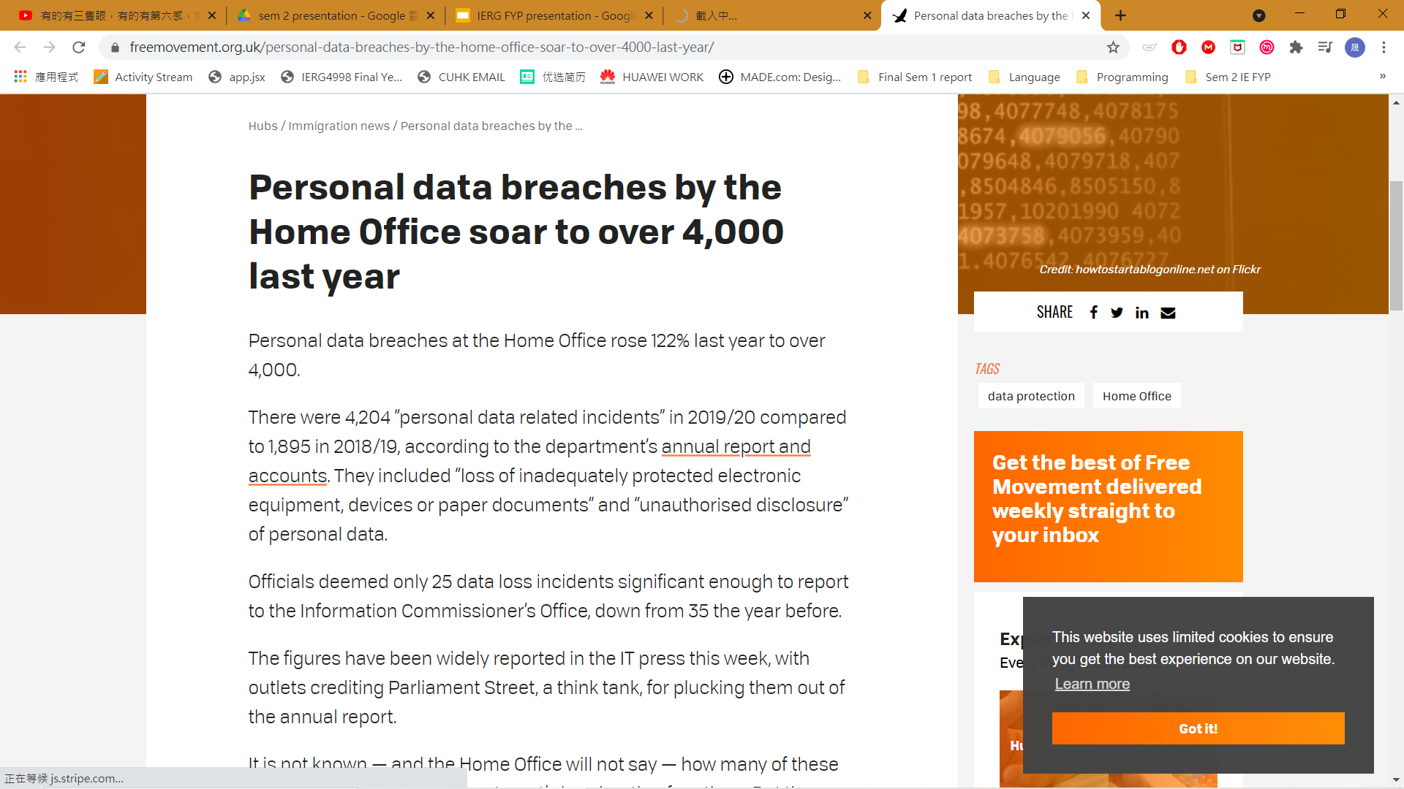
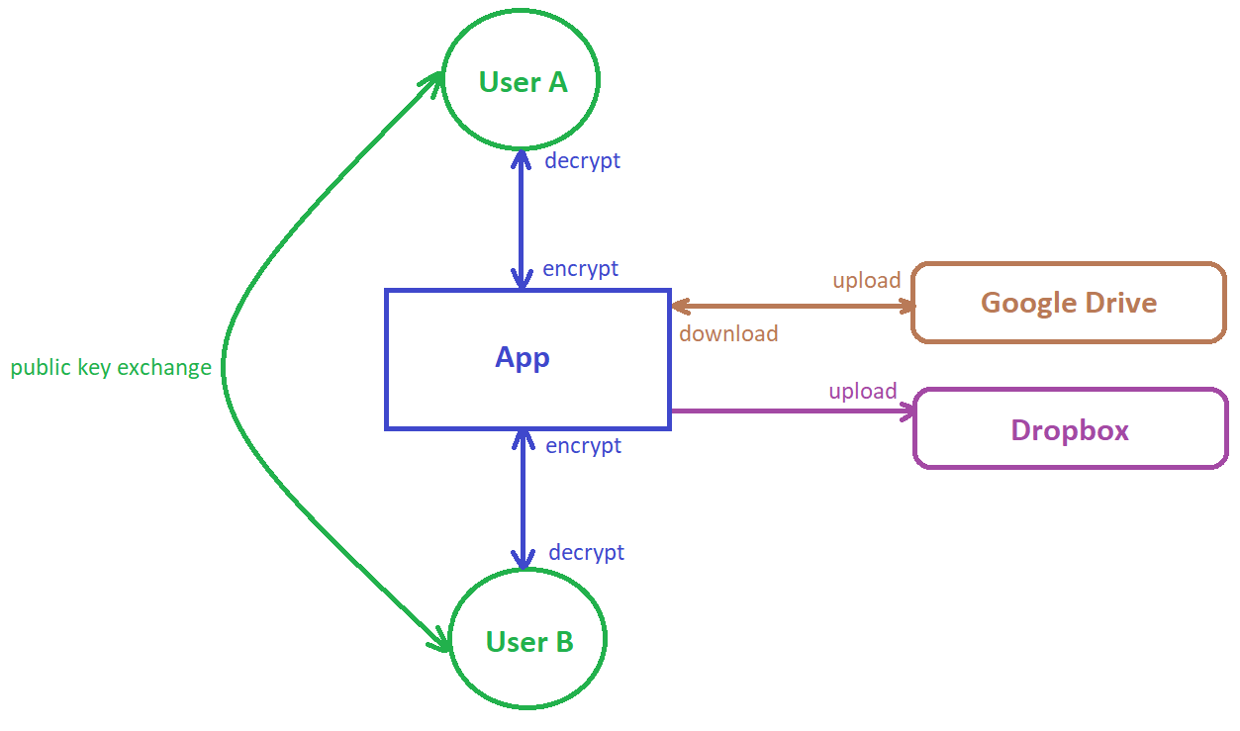
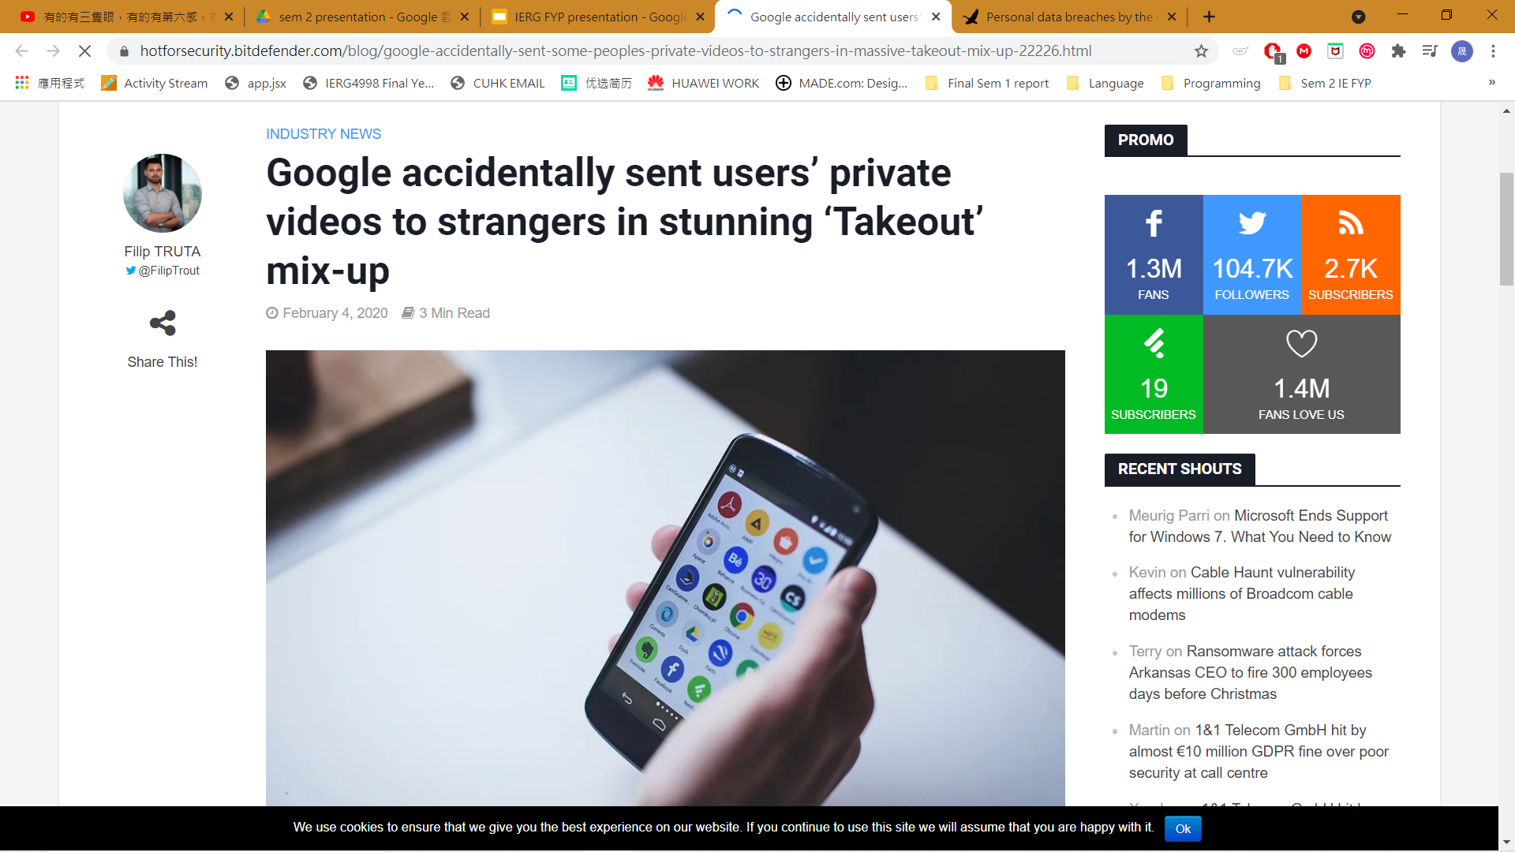
Overview - What are we doing?

Slide 3
Methodology - How to do it?

Slide 4
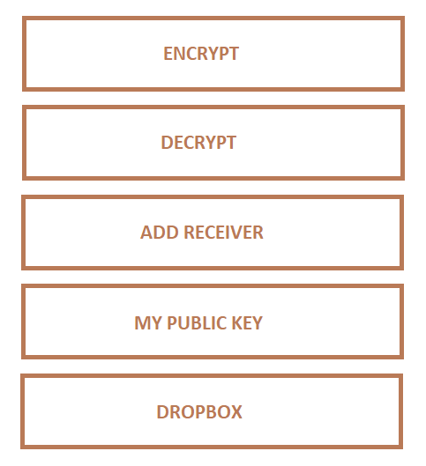
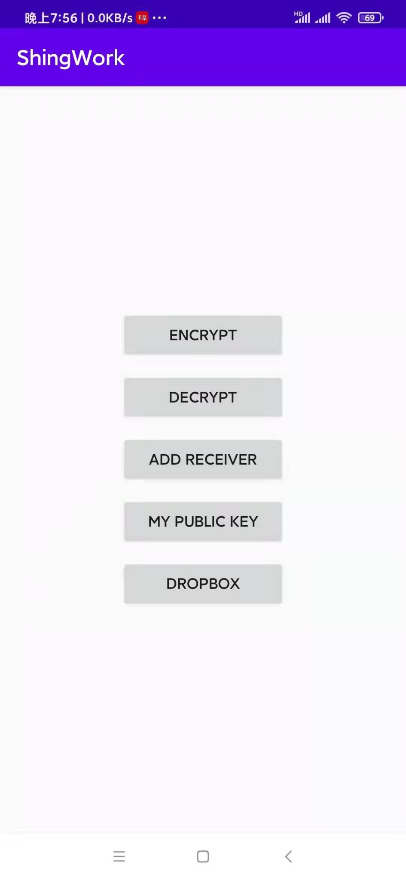
The app layout
Notes:
2:00

Slide 5
Encryption and Decryption (Own Use)
Notes:
2:00

Slide 6
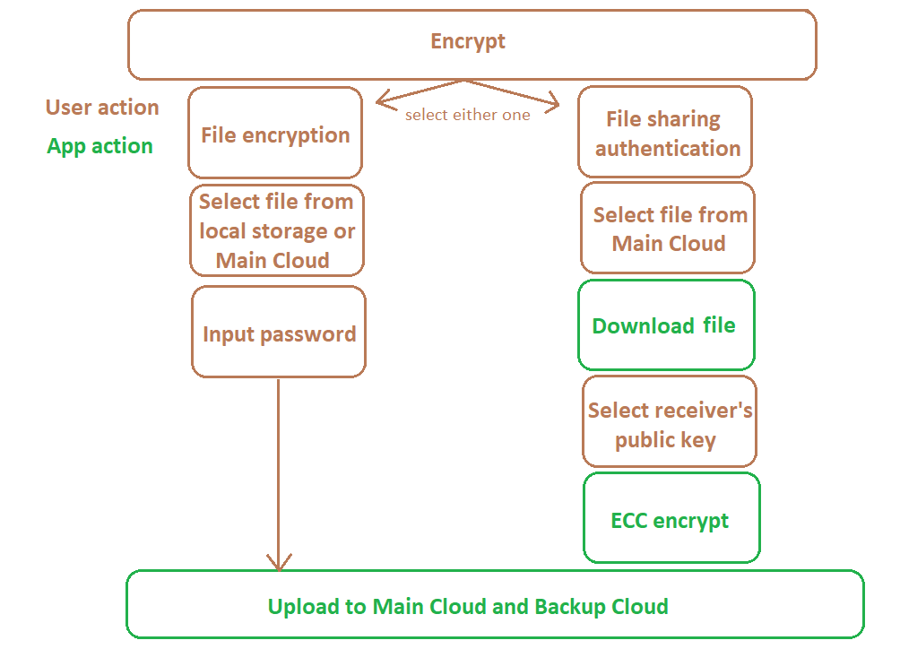
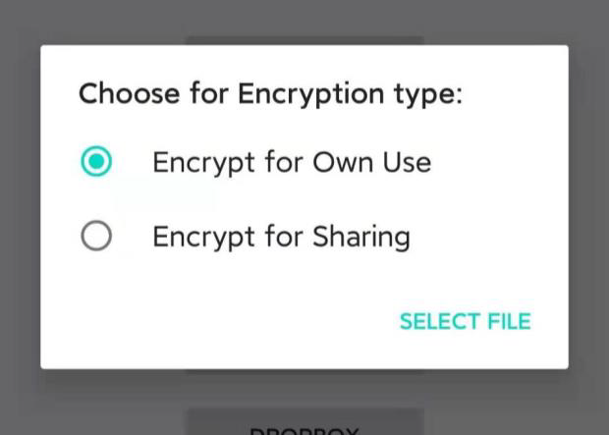
Encryption (Own Use)

Slide 7
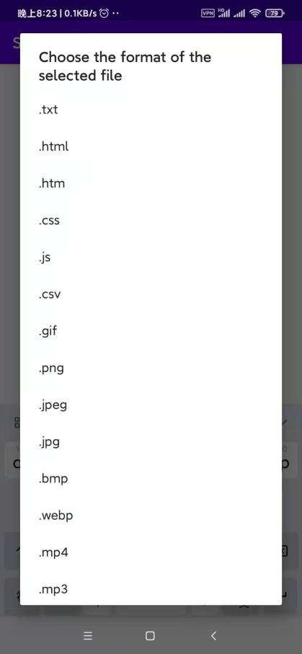
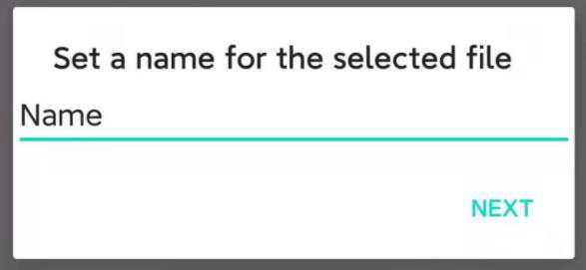
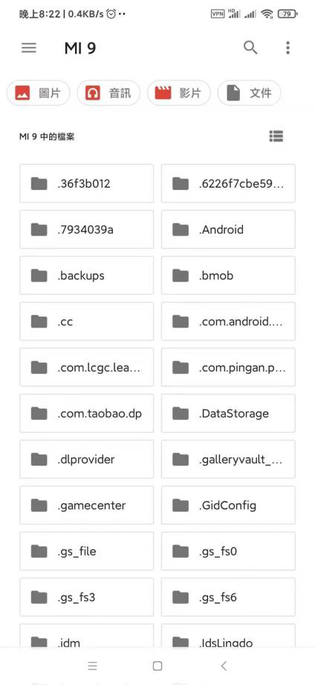
Encryption (Own Use)

Slide 8
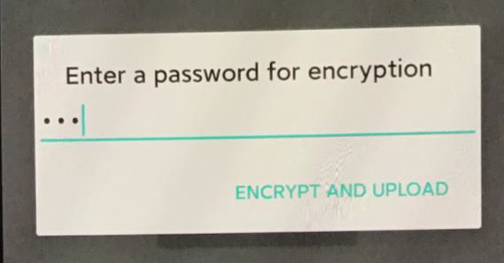
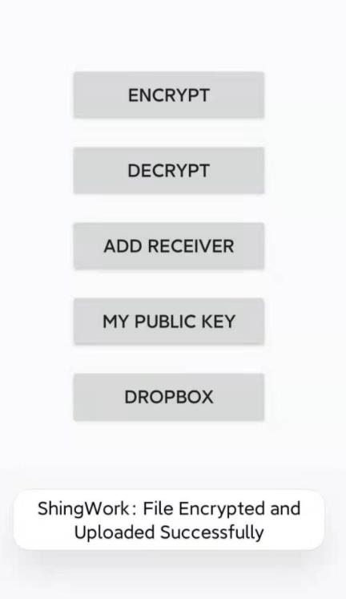
Encryption (Own Use)
Notes:
the place of the security. Generate the secret key based on the user’s password. The technique used is PBKDF2. Then the file is encrypted with algorithm ChaCha20-Poly1305, which is an efficient encryption algorithm for smartphones.

Slide 9
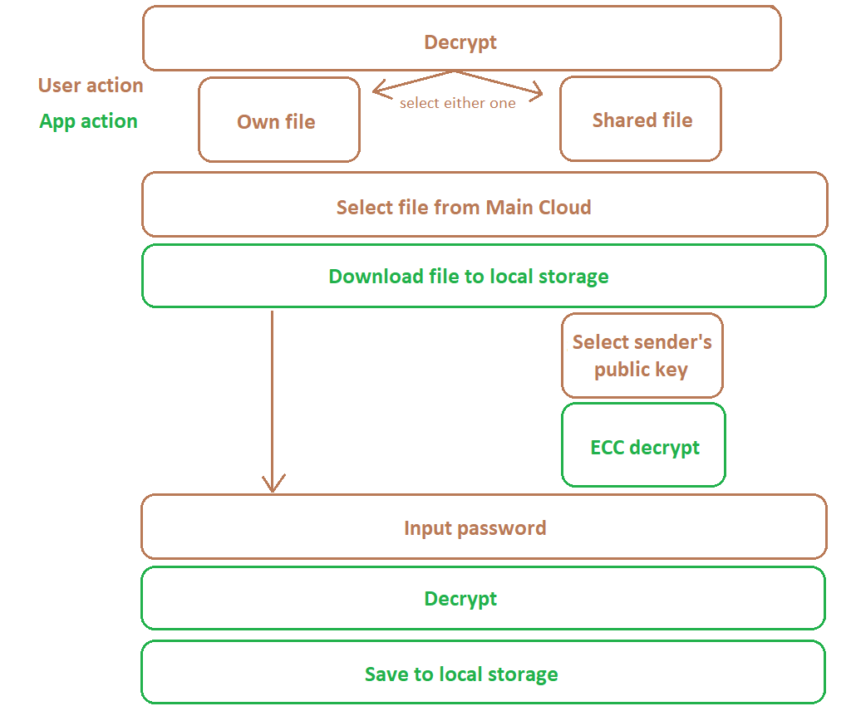
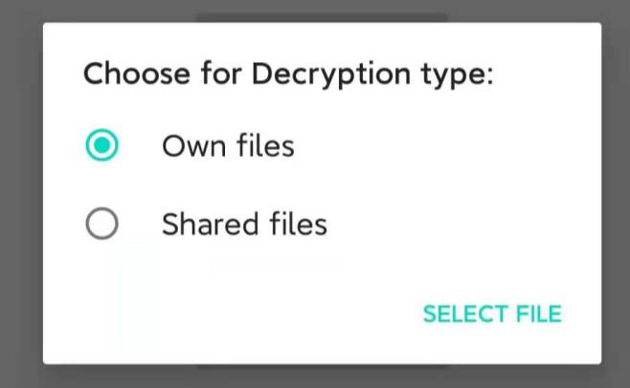
Decryption (Own Use)

Slide 10
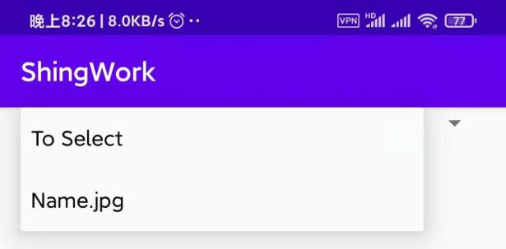
Decryption (Own Use)

Slide 11
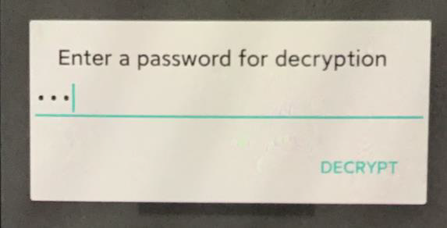
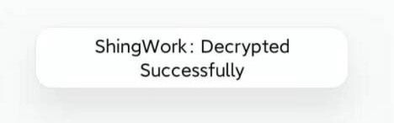
Decryption (Own Use)
Notes:
Enter the same password. Same secret key is generated and same cipher is used, decryption done.

Slide 12
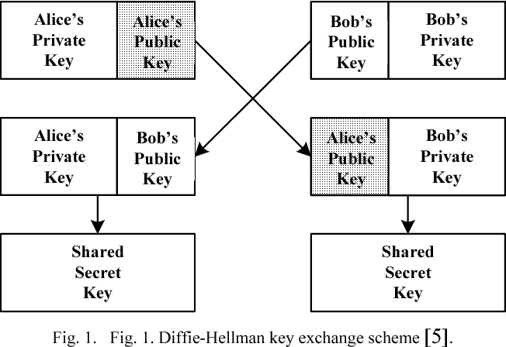
Asymmetric Encryption Idea （ECDH）
Sender
Receiver
same
[1]

Slide 13
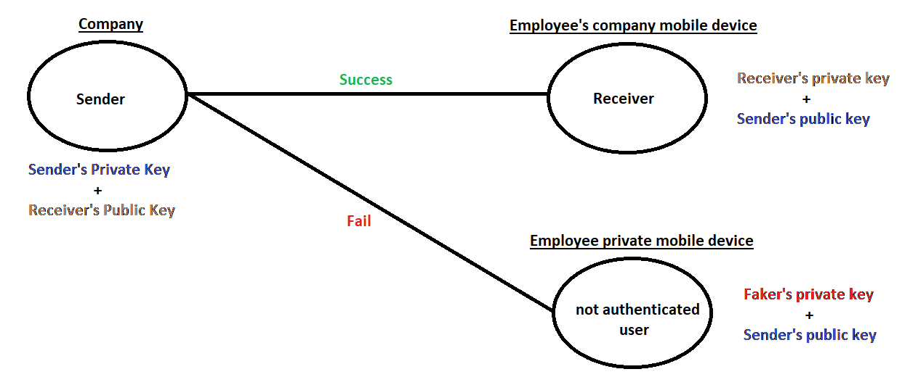
Asymmetric Encryption Idea
Device Authentication
Notes:
We need to do authentication, to check if the receiver is real or fake. To do the authentication, please refer to the graph. Then the secret key is used to encrypt the encrypted file. Double encryption done.

Slide 14
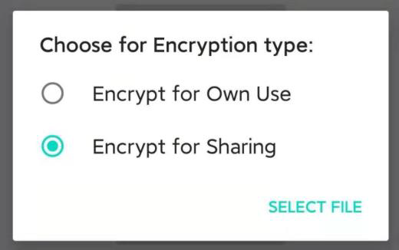
Encryption (Sharing)

Slide 15
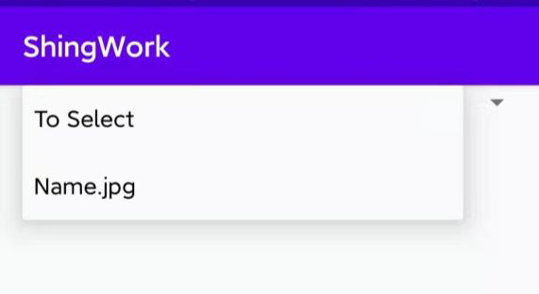
Encryption (Sharing)

Slide 16
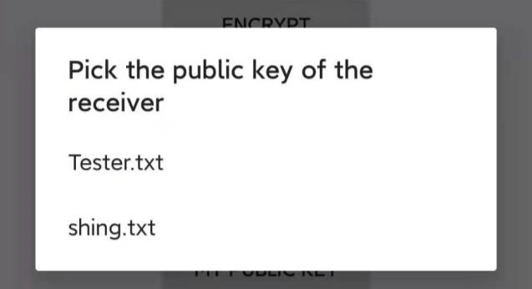
Encryption (Sharing)
Notes:
private key from private memory. Public key selected. Shared Secret key generated.

Slide 17
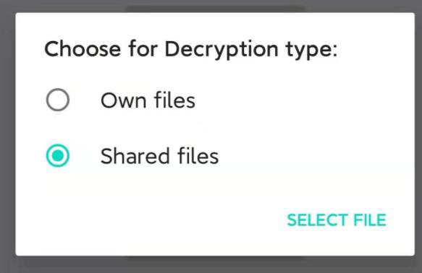
Decryption (Sharing)

Slide 18
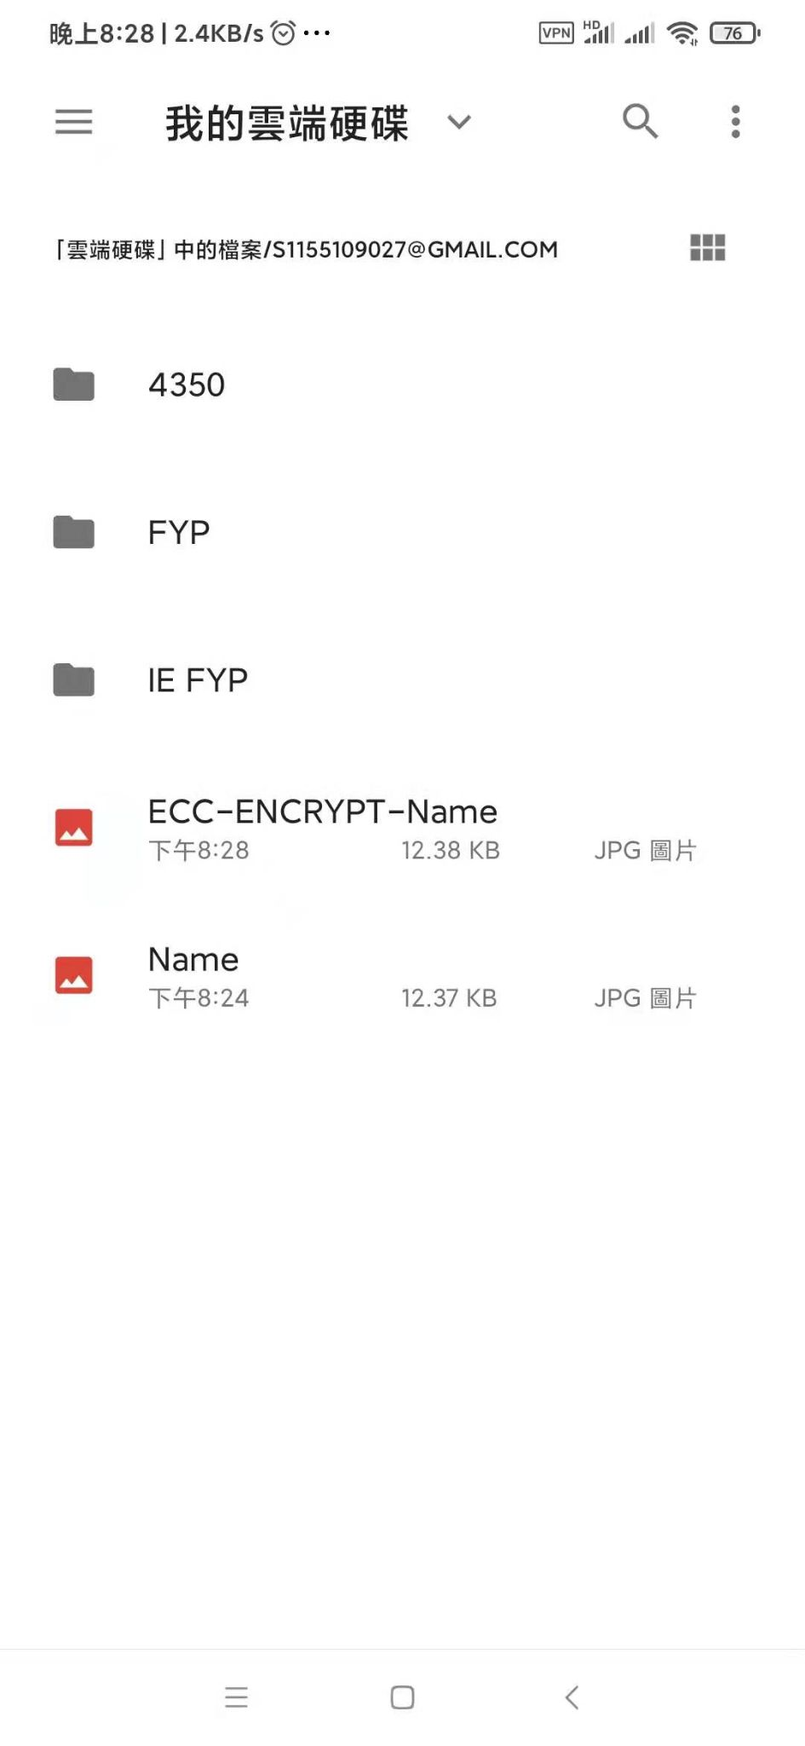
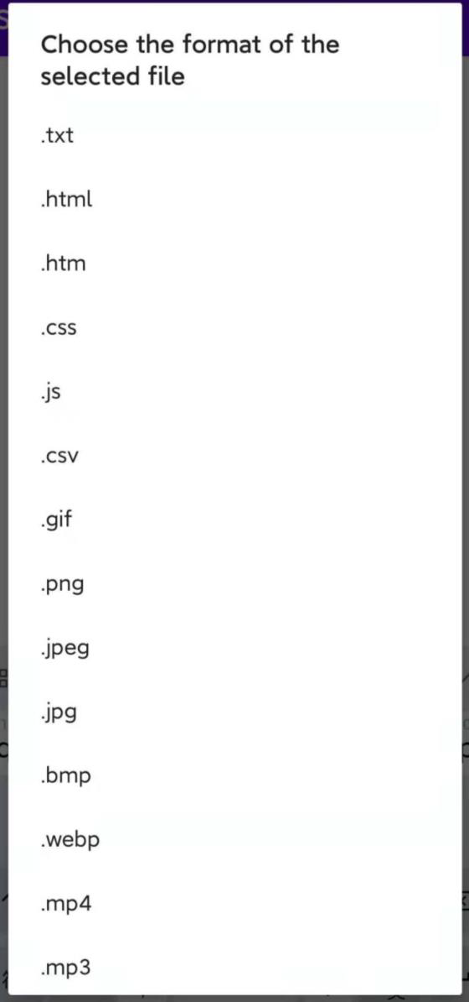
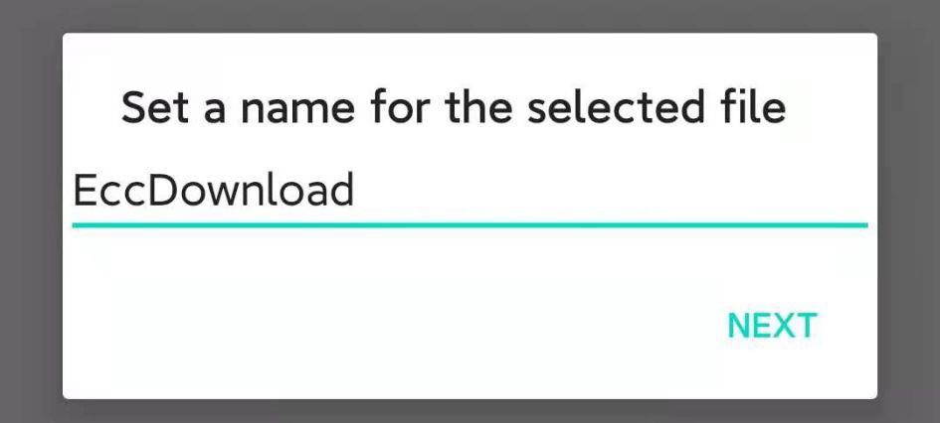
Decryption (Sharing)

Slide 19
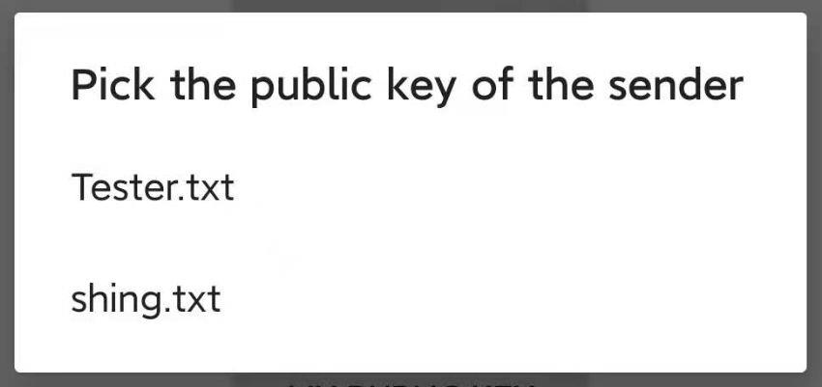
Decryption (Sharing)

Slide 20
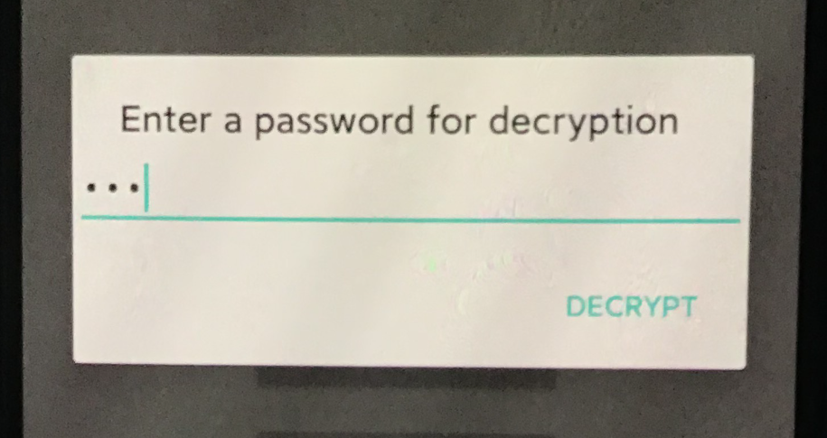
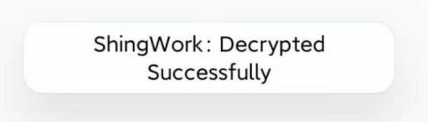
Decryption (Sharing)

Slide 21
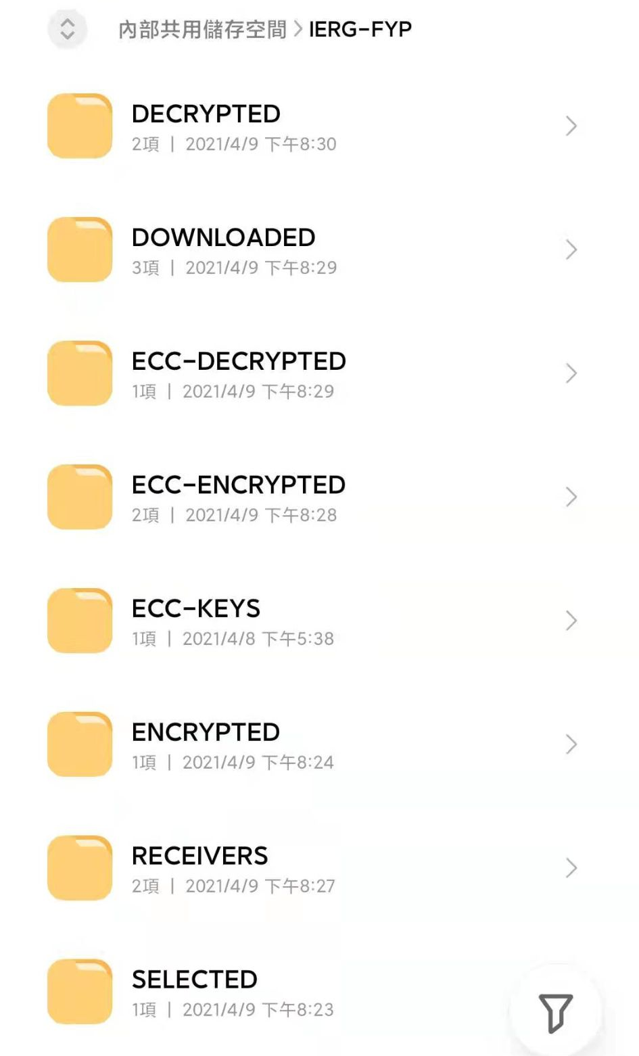
Folder management

Slide 22
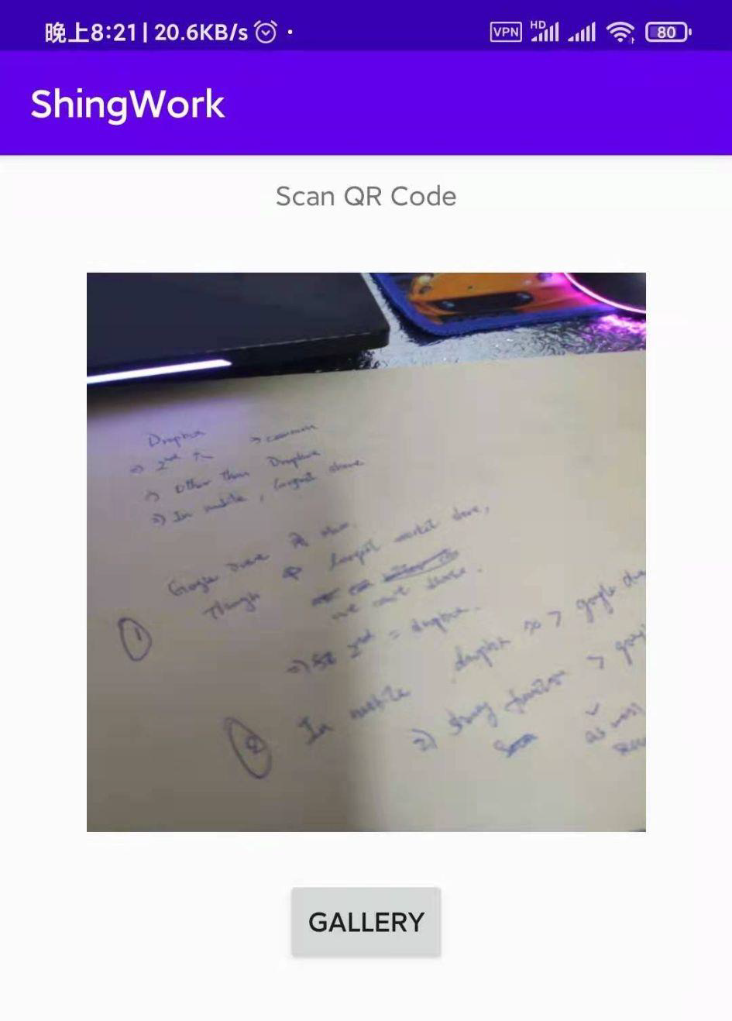
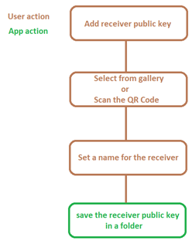
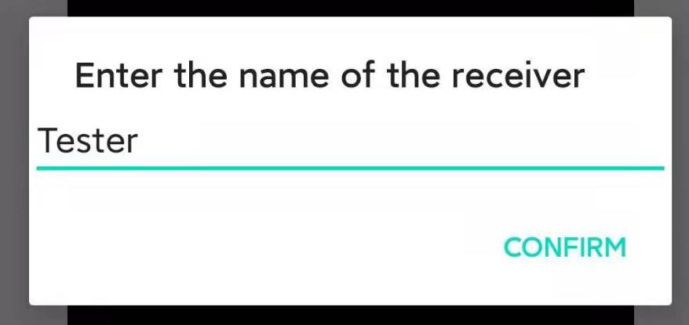
Add receiver public

Slide 23
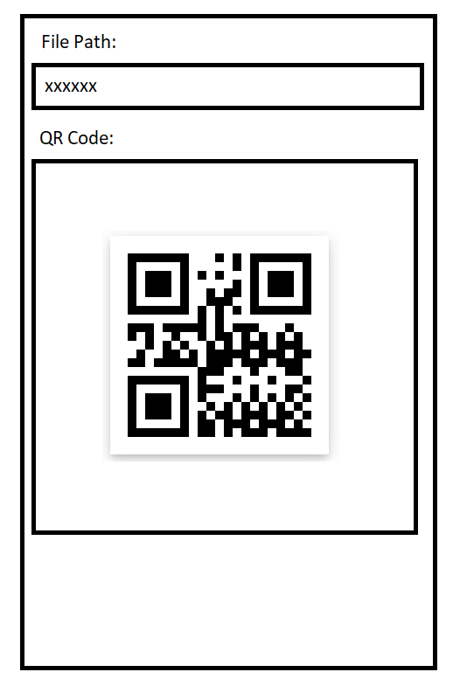
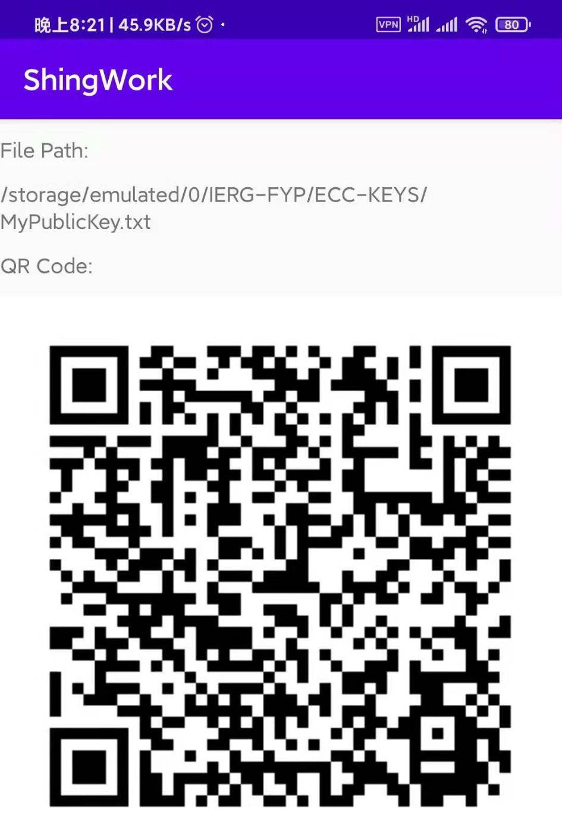
My public key

Slide 24
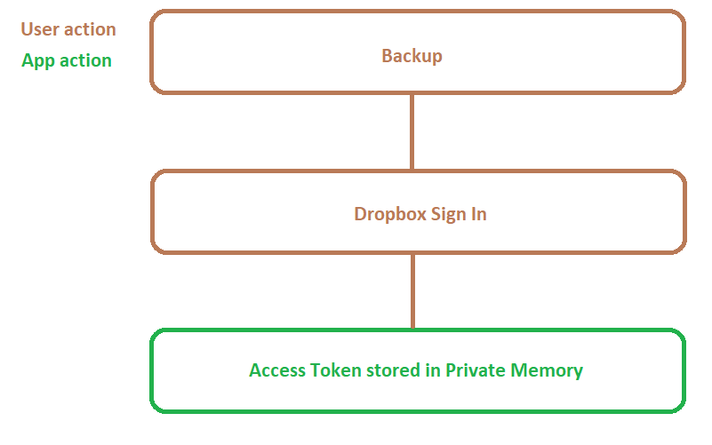
Design - Backup

Slide 25
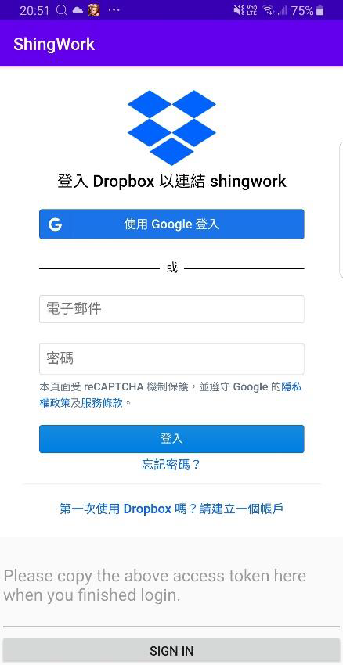
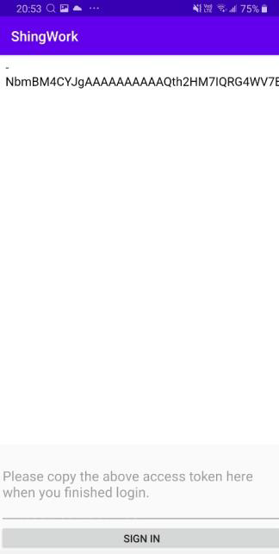
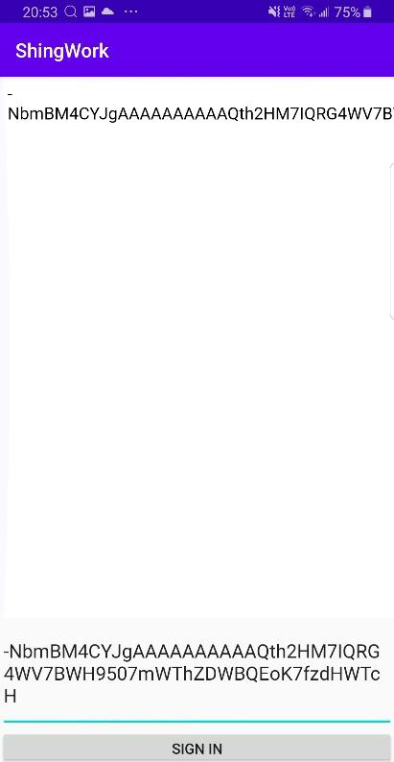
Implementation - Backup

Slide 26
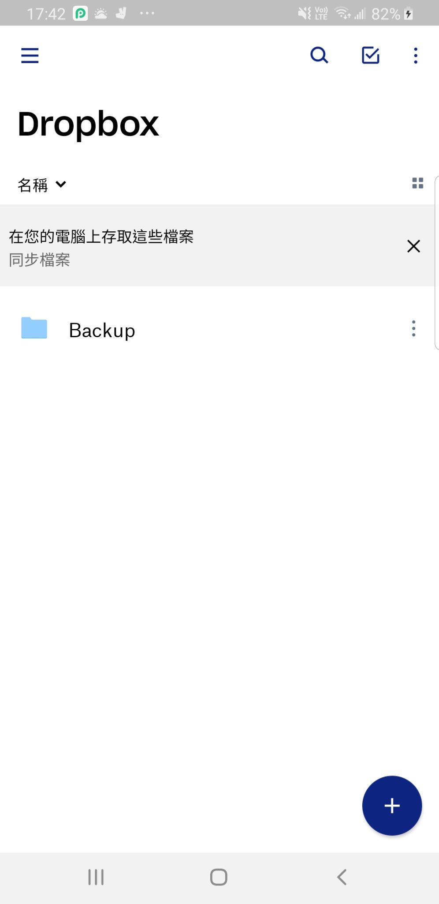
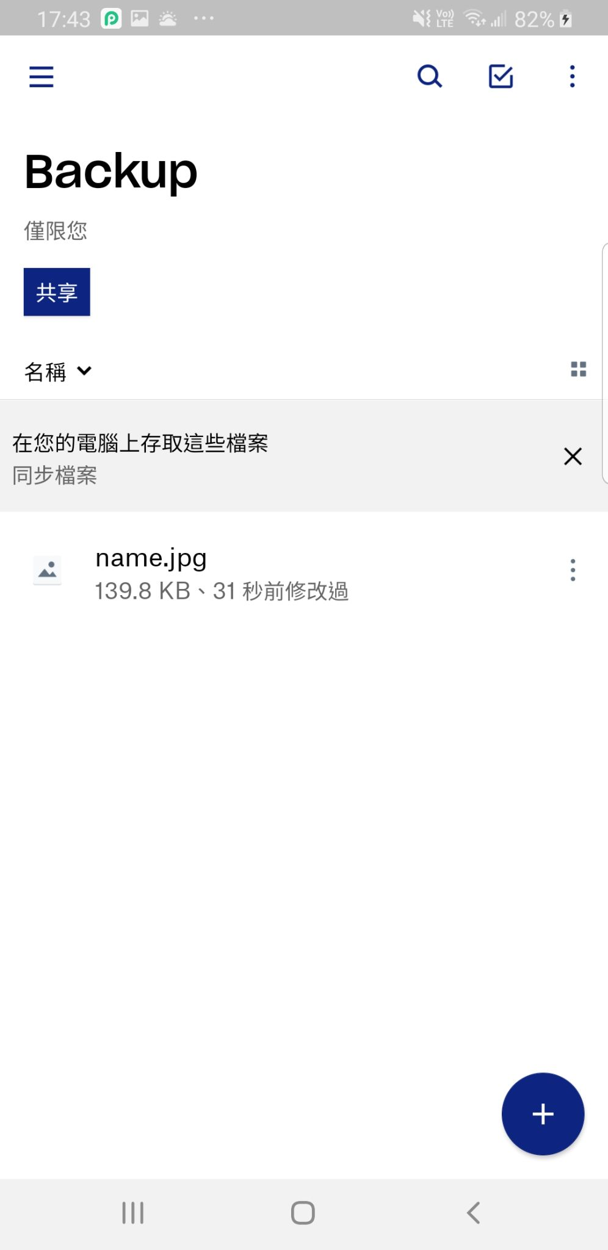
Implementation - Backup

Slide 27
Importance of Backup
recover the encrypted files
2. prevent the corruption of the main cloud service
Notes:
7:30

Slide 28
Test
Aim:
1. perform time comparisons between AES-GCM and ChaCha20Poly1305.
2. perform time comparisonsbetween RSA OAEP and ECDH.

Slide 29
Test equipment
Samsung S8+:
1. 64-bit octa-core CPU
2. 6GB RAM (Random Access Memory)

Slide 30
Symmetric encryption setting
Symmetric Key Algorithm | ChaCha20-Poly1305 | AES-GCM
Key Spec | PBKDF2withHmacSHA1 | PBKDF2withHmacSHA1
Password-based key iteration | 1000 | 1000
Padding | No Padding | No Padding
Key length | 256 | 256
Nonce (bytes) | 12 | 16

Slide 31
Asymmetric encryption setting
Asymmetric Key Algorithm | ECDH | RSA
Key Spec | ECC | RSA
Padding | No Padding | OAEP
Encryption Algorithm | ChaCha20-Poly1305 | AES-GCM
Comparable key size | 256 | 3072

Slide 32
Evaluation(Symmetric encryption result)
Algorithm / file size | 102.4KB (ms) | 1MB (ms) | 10MB (ms) | 100MB (ms)
ChaCha20-Poly1305 with PBKDF2withHmacSHA1 | 27.67 | 41.33 | 102.67 | 644
AES GCM with PBKDF2withHmacSHA1 | 36.67 | 140.67 | 1090.67 | 10611.67
Ratio (AES-GCM)/ (ChaCha20-Poly1305) | 1.33 | 3.40 | 10.62 | 16.48

Slide 33
Evaluation(Asymmetric encryption result)
Algorithm / file size | 102.4KB (ms) | 1MB (ms) | 10MB (ms) | 100MB (ms)
ECDH with ChaCha20-Poly1305 256 bits | 3.67 | 9.33 | 63.67 | 550
RSA OAEP with AES-256 GCM 3072 bits | 1594 | 1979.67 | 3003.67 | 12108
Ratio (RSA OAEP) / (ECDH) | 434.33 | 212.18 | 47.18 | 22.01

Slide 34
Evaluation(Symmetric encryption result)
Algorithm / file size | 102.4KB (ms) | 1MB (ms) | 10MB (ms) | 100MB (ms)
ChaCha20-Poly1305 with PBKDF2withHmacSHA1 | 27.67 | 41.33 | 102.67 | 644
AES GCM with PBKDF2withHmacSHA1 | 36.67 | 140.67 | 1090.67 | 10611.67
Ratio (AES-GCM)/ (ChaCha20-Poly1305) | 1.33 | 3.40 | 10.62 | 16.48

Slide 35
Evaluation(Asymmetric encryption result)
Algorithm / file size | 102.4KB (ms) | 1MB (ms) | 10MB (ms) | 100MB (ms)
ECDH with ChaCha20-Poly1305 256 bits | 3.67 | 9.33 | 63.67 | 550
RSA OAEP with AES-256 GCM 3072 bits | 1594 | 1979.67 | 3003.67 | 12108
Ratio (RSA OAEP) / (ECDH) | 434.33 | 212.18 | 47.18 | 22.01

Slide 36
Evaluation(ChaCha20-Poly1305 encryption result)
Algorithm / file size | 102.4KB (ms) | 1MB (ms) | 10MB (ms) | 100MB (ms)
ChaCha20-Poly1305 | 1.27 | 5.85 | 47.56 | 417.87
Algorithm / file size | 102.4KB (ms) | 1MB (ms) | 10MB (ms) | 100MB (ms)
PBKDF2withHmacSHA1 | 26.4 | 35.48 | 55.11 | 226.13
ECDH | 2.4 | 3.48 | 16.11 | 132.13
Notes:
12:30

Slide 37
Test limitation
1. RSA OAEP can only encrypt files smaller than its key length.
2. ECDH because they cannot match the comparable security level.

Slide 38
Future work
1. Provide more cloud service options such as Microsoft OneDrive.
2. Choose the cloud service providers according to their own preferences.

Slide 39
Conclusion
1. file encryption and sharing authentication
2. better performance on time and security
3. backup function

Slide 40
Reference
[1] M. H. Azaim, D. W. Sudiharto, and E. Jadied, “Design and implementation of encrypted SMS on Android smartphone combining ECDSA - ECDH and AES: Semantic Scholar,” SEMANTIC SCHOLAR, 01-Jan-2016. [Online]. Available: https://www.semanticscholar.org/paper/Design-and-implementation-of-encrypted-SMS-on-ECDSA-Azaim-Sudiharto/a58cb37fd0dac4db94a099edb3ac85f28abc9509#citing-papers. [Accessed: 12-May-2021].

Slide 41
Thank you!

